Slide 1
Disqualified Leads Analysis report
Prepared by Oluwatosin Akindolie Dec 24

Slide 2

Project Overview
Motivation
StudyNow aims to analyse disqualified leads to identify key trends in subject preferences, study destinations, demographics, and lead sources for improved or tailored study abroad options.
Objectives
Identify most requested subject areas
Analyse preferred study destinations
Examine geographic trends (states & nationalities)
Evaluate lead source performance
Extract actionable insights for strategy refinement
Scope
The dataset includes data on disqualified leads of students looking to study abroad from different countries and cities.

Slide 3
Metrics
Leads
3049
Cities
206
Courses
13
Nationalities
62
Study Destination
11

Slide 4
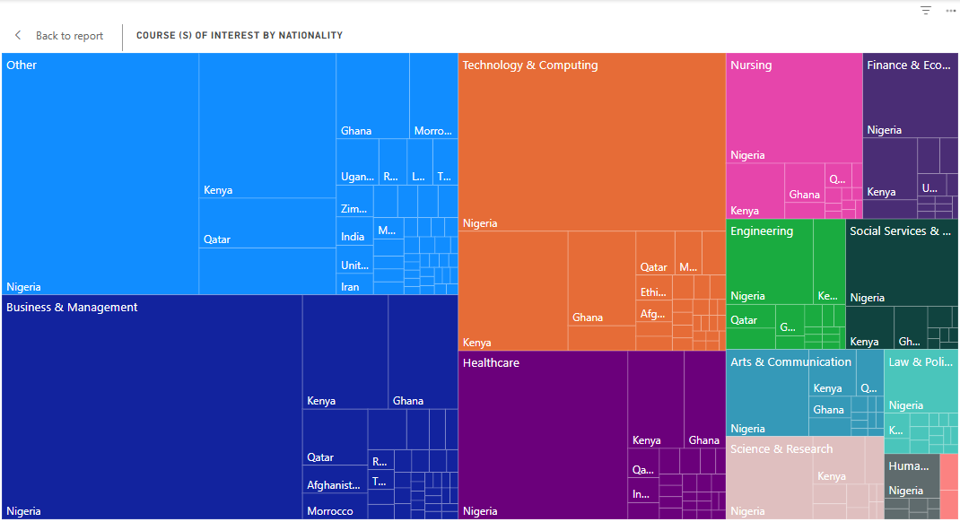
Descriptive Analysis - Top 3 Common Subject Areas
Nigeria leads with the highest number of leads across diverse subject areas such as business, technology, health, education, and law. Other prominent countries include Ghana, Kenya, Qatar, India, and Uganda, with interests spanning similar fields

Slide 5
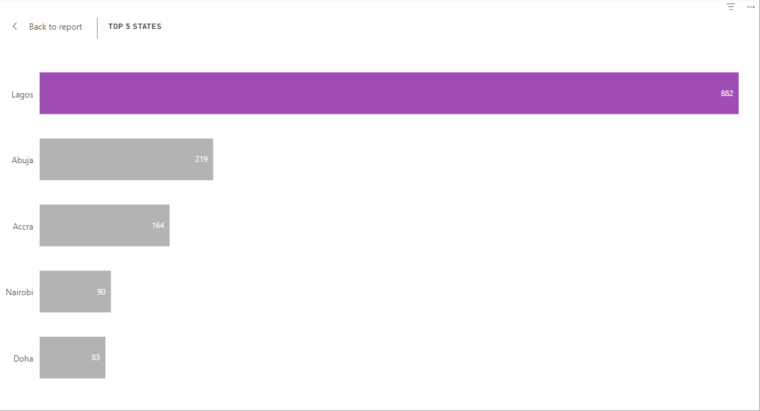
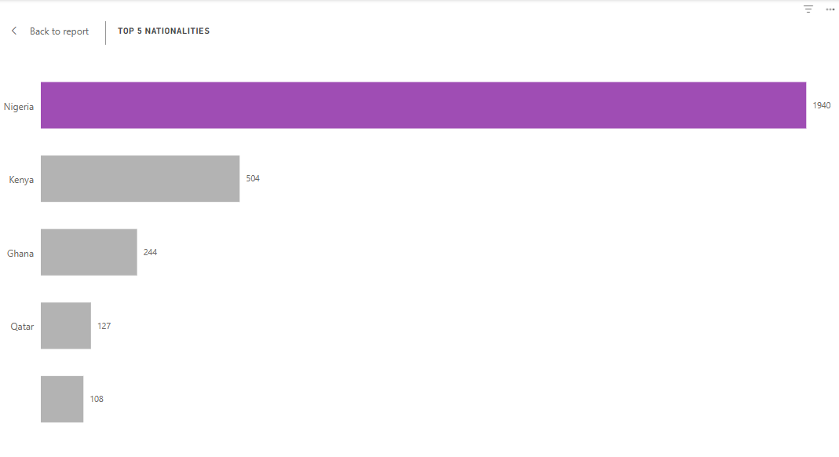
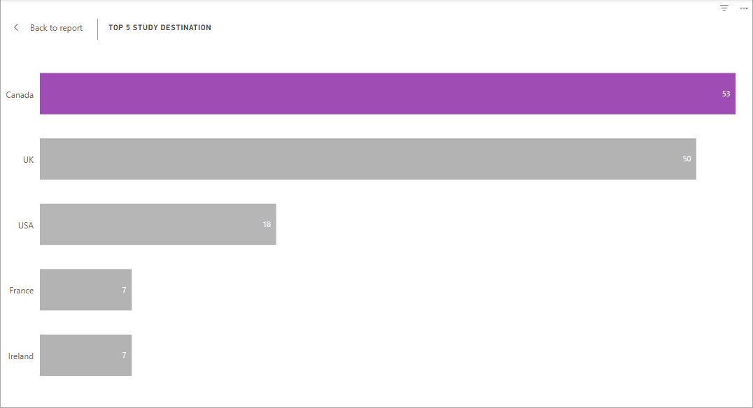
Descriptive Analysis - Location
Majority of leads are from Nigeria, Lagos in particular and their most preferred study destination is Canada and UK.
Top 5 Study Destinations
The most preferred destinations are Canada, UK, USA, France, and Ireland reflecting their global appeal for education and diverse program offerings.
Top 5 states
Lagos has the highest number of disqualified leads.
Top 5 Nationalities
Nigeria has the highest number of disqualified leads.

Slide 6
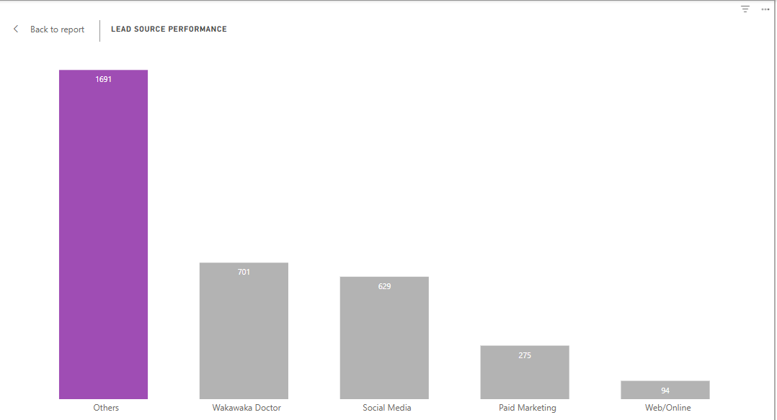
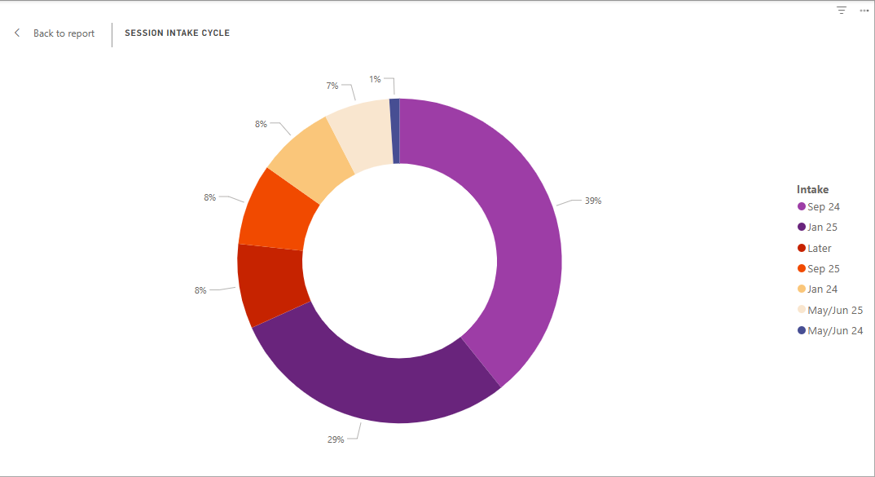
Major Trend Summary
Lead Sources
Aside the data from Others, majority leads originated from Wakawaka Doctor and Social Media, indicating these platforms may require better targeting or filtering mechanisms.
Preferred Intakes
The majority of leads are aiming for September 2024 and January 2025 resumption periods, suggesting these are the most sought-after start times for study programs.

Slide 7
Recommendations
Implement a prefilled form that allows users to select multiple choices for fields such as the "Course of Interest," "Country of Study," "Country of Residence," and "Source of Information.
Have a dedicated tab or section where users can select the type of degree they are interested in (e.g., Bachelor's, Master's), followed by a list of relevant courses they can choose from.
Implement a multi-choice selection system, either as checkboxes or a multi-select dropdown. Also, ensure there is a text box or "Other" option for users to provide additional details.
Since Nigeria particularly lagos, Abuja has majority prospective applicants, marketing efforts should be tailored to effectively reach and engage this audience.
Additional data fields for analysis:
Lead Status/Qualification Reason: Adding a column that explains why a lead was disqualified can provide deeper insights into which factors are causing disqualifications. It can also help to tailor the marketing and lead qualification processes.
Education Level: Including current educational level would also help identify what certain academic backgrounds are more likely to be qualified leads.
Power BI Visualization Attached to email

Slide 8
THANK YOU

